Slide 1

Advanced course
Lesson 31
DIY coures（9）
Fruit responder
YahBoom Croco:Kit tutorial

Slide 2
Advanced course
Content
Part1
Part 2
Part3
Part 4
Part 5
Learning goals
Preparation
Connection
Search for blocks
Combine blocks
YahBoom Croco:Kit tutorial

Slide 3
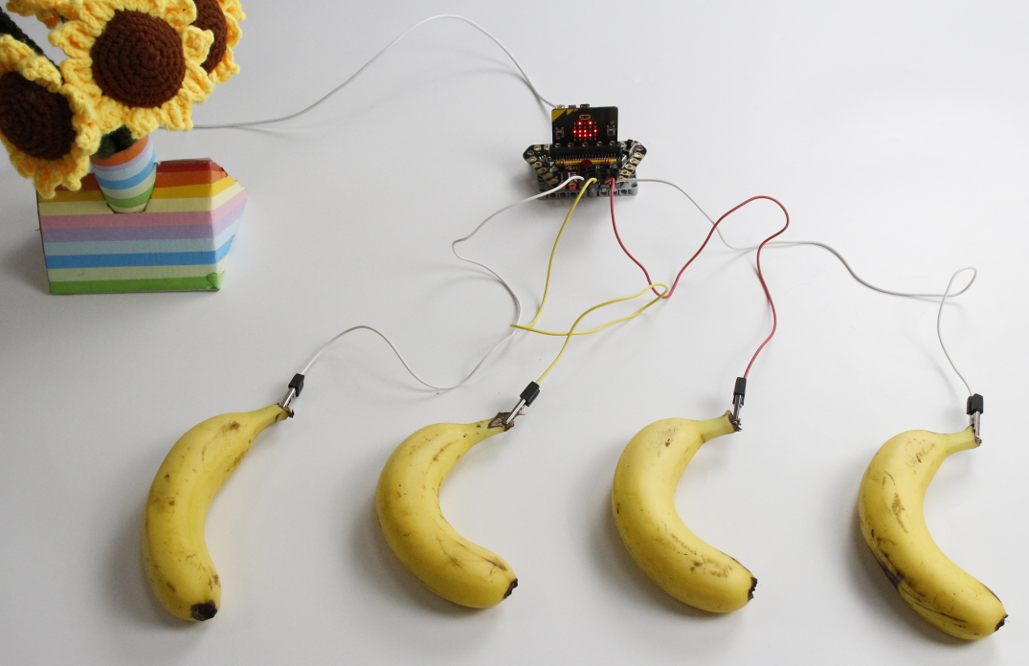
Advanced course
Part 1
Learning goals
After downloading the program, you can see the micro:bit LED dot matrix display ‘Hello!’.Then, micro:bit LED dot matrix will display a “heart” and we can start to answer, which player successfully answered, the corresponding number will be displayed, the music will be played, and the servo will point to the player.
YahBoom Croco:Kit tutorial

Slide 4
Advanced course
Part 2
Hardware:
● 1 X Micro:bit Board
● 1 X Micro USB Cable
● 1 X Diamond breakout
● 4 X Alligator clip
● 1 X Servo
● 1 X PC
Preparation
Mode 1 online programming: First, we need to connect the micro:bit to the computer by USB cable. The computer will pop up a USB flash drive and click on the URL in the USB flash drive: http://microbit.org/ to enter the programming interface. Add the Yahboom package: https://github.com/lzty634158/Croco-Kit to program.
Mode 2 offline programming: We need to open the offline programming software. After the installation is complete, enter the programming interface, click【New Project】, add Yahboom package: https://github.com/lzty634158/Croco-Kit , you can program.
YahBoom Croco:Kit tutorial

Slide 5
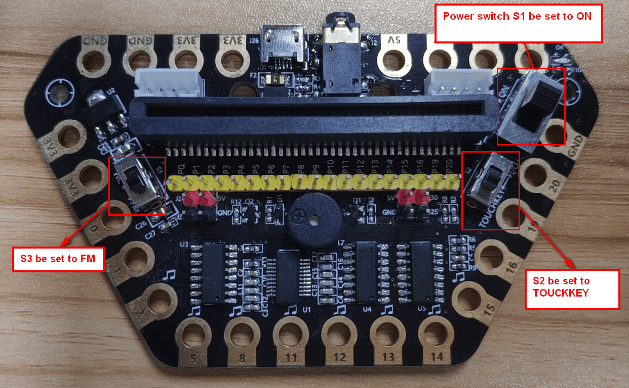
Advanced course
Part 2
Preparation
! ! !Note: S1 be set to the ON, S2 be set to the IO, and S3 to the FM.
YahBoom Croco:Kit tutorial

Slide 6
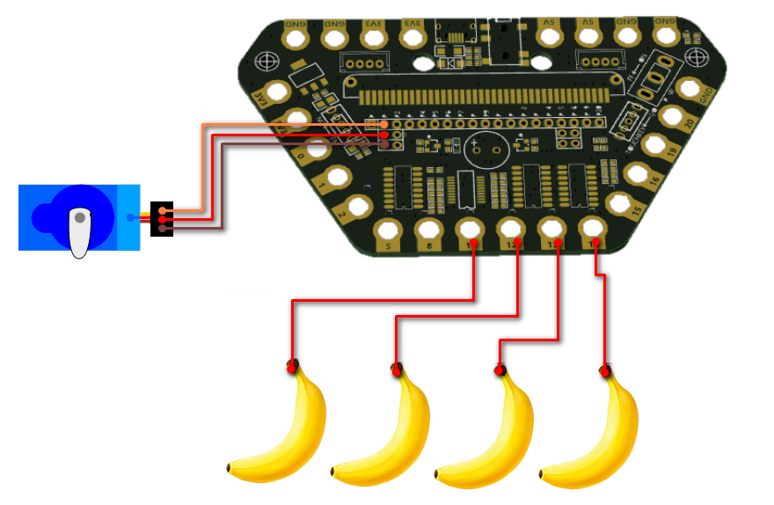
Advanced course
Part 3
Connection
YahBoom Croco:Kit tutorial

Slide 7
Advanced course
Part 3
Expansion board | Servo | Fruit
P11 |  | Fruit No.1
P12 |  | Fruit No.2
P13 |  | Fruit No.3
P14 |  | Fruit No.4
P1 | Orange line
5V | Red line
GND | Black line
Connection
YahBoom Croco:Kit tutorial

Slide 8
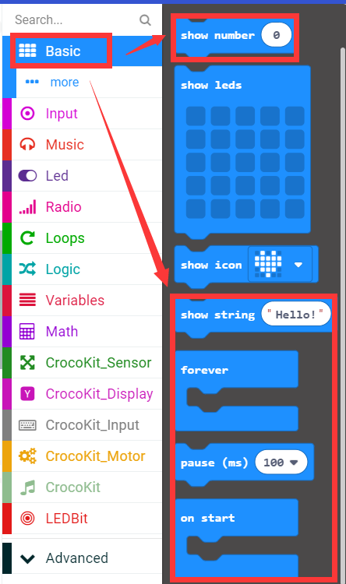
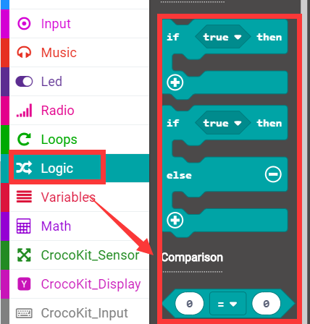
Advanced course
Part 4
Search for blocks
YahBoom Croco:Kit tutorial

Slide 9
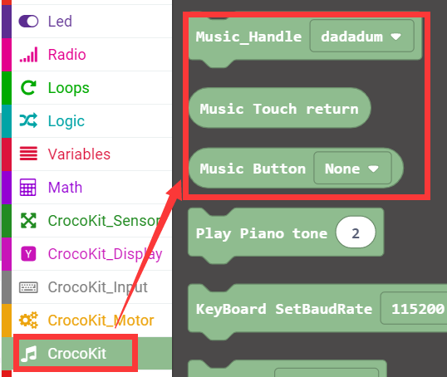
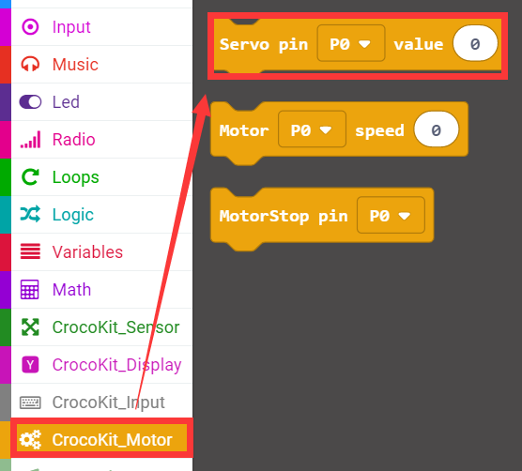
Advanced course
Part 4
Search for blocks
YahBoom Croco:Kit tutorial

Slide 10
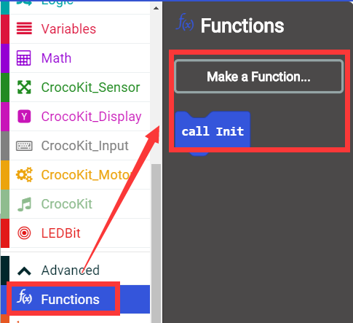
Advanced course
Part 4
Search for blocks
YahBoom Croco:Kit tutorial

Slide 11
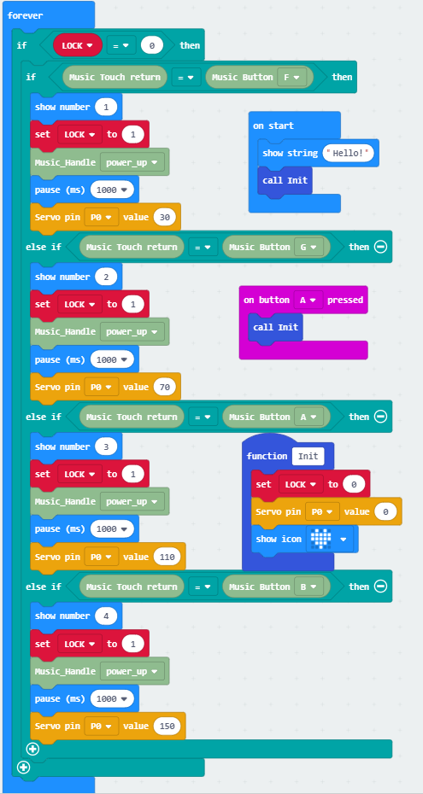
Advanced course
Part 5
Combine blocks
YahBoom Croco:Kit tutorial

Slide 12
Advanced course
Thank you ！
Powered by YahBoom
YahBoom Croco:Kit tutorial

